Slide 1
Southern California Water Dialogue Meeting
Metropolitan Water District of Southern California
Alice Webb-Cole
February 26, 2013

Slide 2
Rebate Program

Slide 3
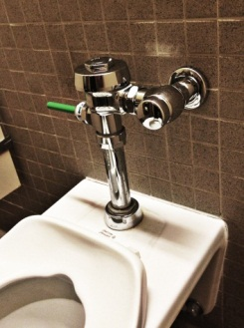
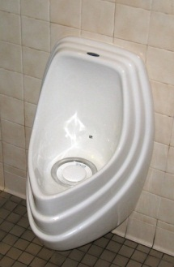
Plumbing
High Efficiency Toilets
Tank, dual flush, flushometer
1.28 gpf or less
Base rebate $100 or $50
Zero / Ultra Low Water Urinals
From zero to .25 gpf
Base rebate $200

Slide 4
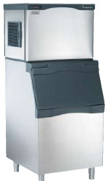
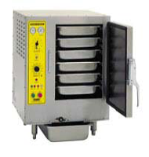
Food Service
Air Cooled Ice Machines
Replace water cooled ice-machine
Base rebate $1,000 per machine
Connectionless food Steamers
Replace boiler based steamers
Base rebate $485/compartment

Slide 5
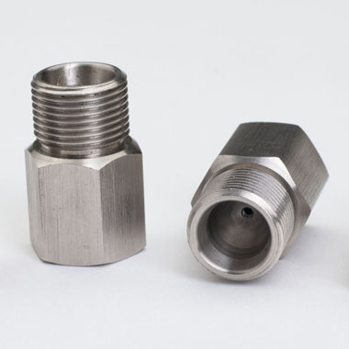
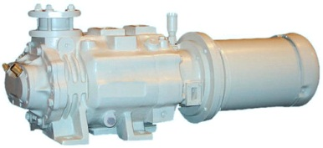
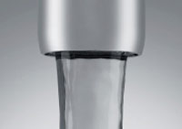
Health Care & Other
Flow control valves
Maintain water pressure & reduce flow in faucets and showers (2.0 gpm or less)
Base rebate:$5 per valve (min of 20)
Dry Vacuum Pumps
2 HP max
Base rebate $125 per ½ HP
Laminar Flow Restrictors
Health care-related facilities only
Base rebate $10 each

Slide 6
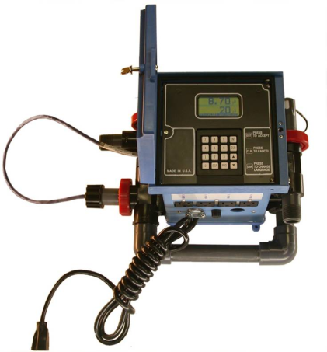
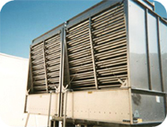
Cooling Tower Controllers
Conductivity Controllers
Base rebate $625
pH Conductivity Controllers
Base rebate $1,750

Slide 7
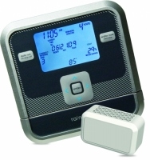
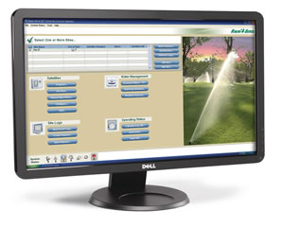
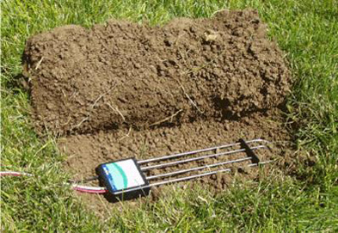
Landscape - Controllers
Weather Based Irrigation Controllers
Based on hist. or real-time weather data
Base rebate $25/station
Central Computer Irrigation Controller
Base rebate $25/station
Soil Moisture Sensor System
Sensor/calibrator & controller
Base rebate $25/station

Slide 8
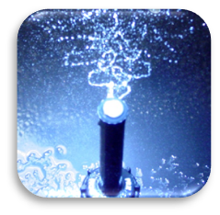
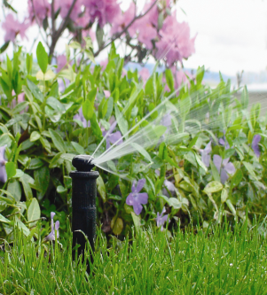
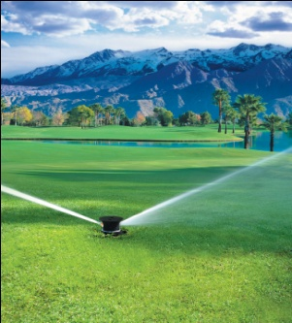
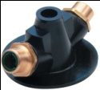
Landscape - Nozzles
Rotating Spray Nozzles
Multi-stream/multi-trajectory
Base rebate $4 per nozzle
Large Rotary Nozzles
Long range watering
Base rebate $13/set

Slide 9
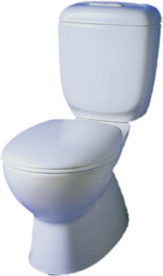
Residential Plumbing
High Efficiency Toilets
Tank, dual flush
1.28 gpf or less
Base rebate $50
High Efficiency Clothes Washers
Water factor 4.0 or better
Base rebate $85

Slide 10
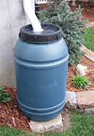
Residential Landscape
Rotating Spray Nozzles
Base rebate $4 per nozzle
Weather Based Irrigation Controllers
Base rebate $80 ($25/station >1 acre)
Soil Moisture Sensor System
Base rebate $80 ($25/station >1 acre)
Rain Barrels
Min 50 gallon; Max 4 per home
Rebate $75 per barrel

Slide 11
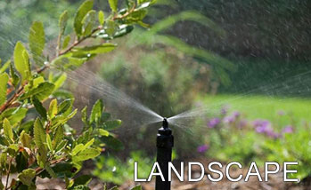
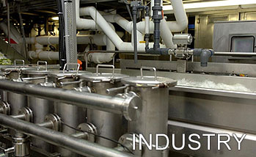
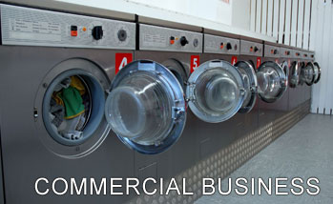
Water Savings Incentive Program
Encourage custom projects
Eligible projects
Industrial process improvement
Irrigation system improvement
Retrofit old equipment
Incentives
$195/AF for measured water savings
$150/AF for estimated water savings
Up to 10 year life
Up to 50% of eligible project co

Slide 12
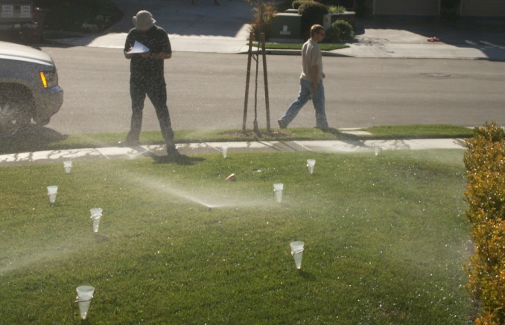
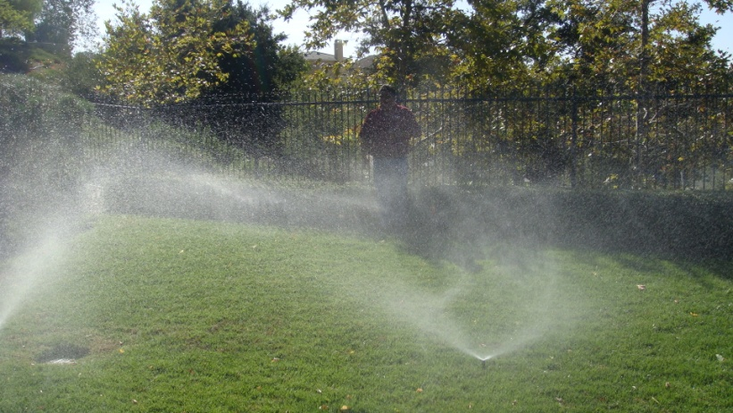
Commercial Landscape Surveys
No cost
Minimum 1 acre irrigated area
Commercial, institutional, public agencies, HOAs common areas
Recommendations to improve water efficiency

Slide 13
Residential Landscape Classes

Slide 15
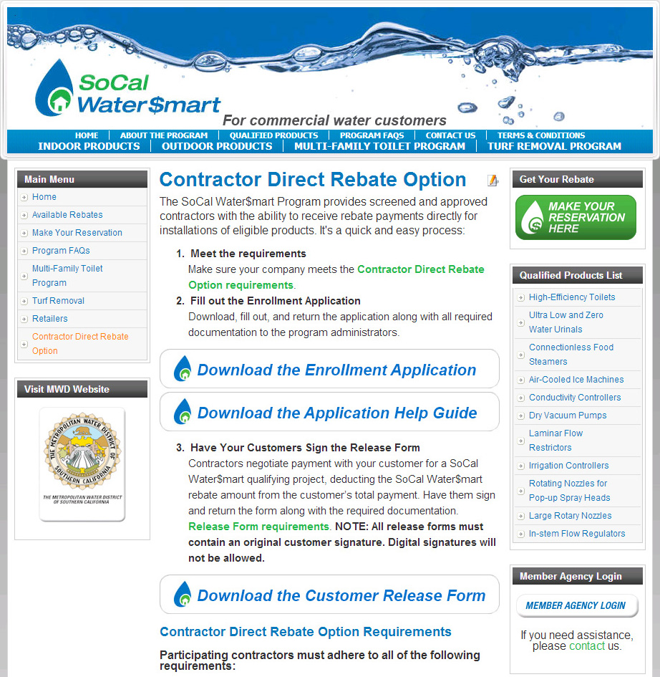
Contractor Direct Rebates
Contractors installing qualifying water efficiency products can now receive rebates directly from SoCal Water$mart.
www.SoCalWaterSmart.com

Slide 16
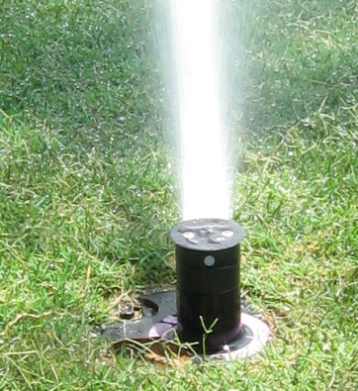
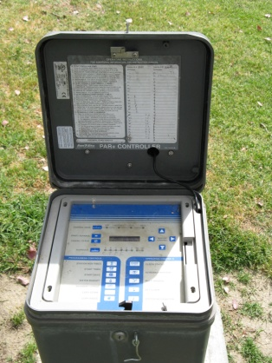
Public Agency Landscape Program
Up-front payments
Enhanced Rebates
Irrigation controllers: $40/station
Weather-Based
Central Computer
Soil Moisture Sensor Systems
Rotating spray nozzles: $6/nozzle
Large rotary nozzles: $13/set (of 2)

Slide 17
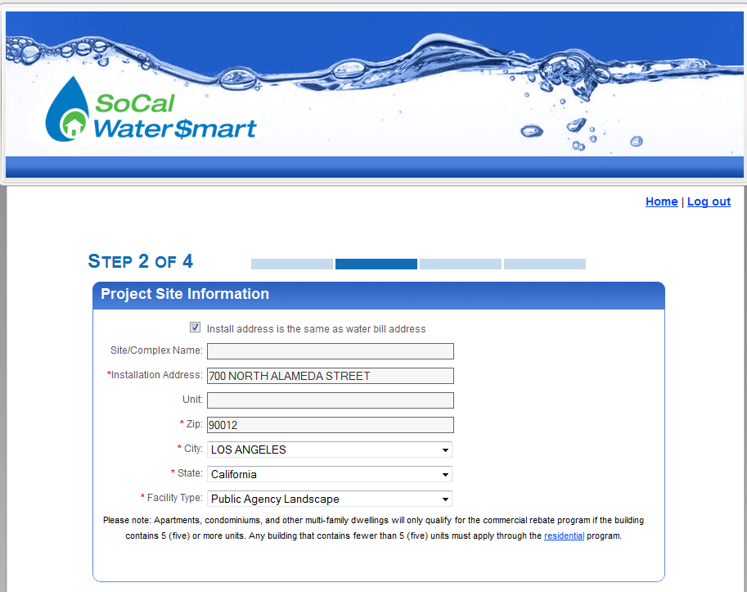
Public Agency Landscape Program
Online application:
“Public Agency Landscape” for facility type

Slide 18
Fitness Center Program
Increased incentives for:
High-Efficiency Toilets at $300/toilet
Ultra-Low-Water Use Urinals at $500/urinal
Can include installation costs
Standard incentive for other items:
Cooling Towers
Landscape Devices

Slide 19
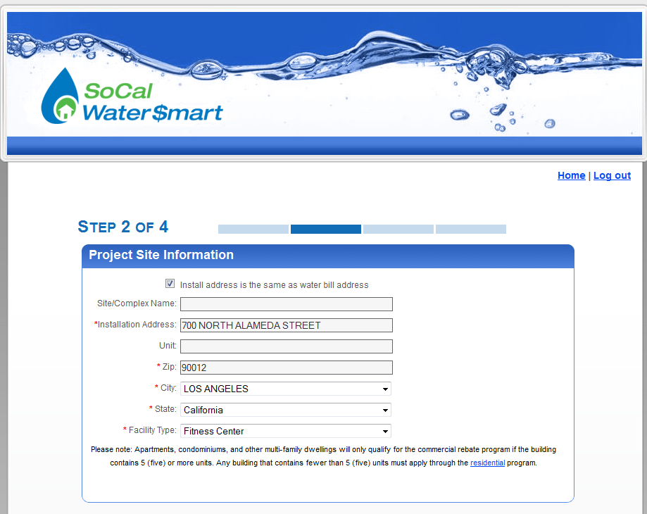
Fitness Center Program
Online application:
“Fitness Center” for facility type

Slide 20
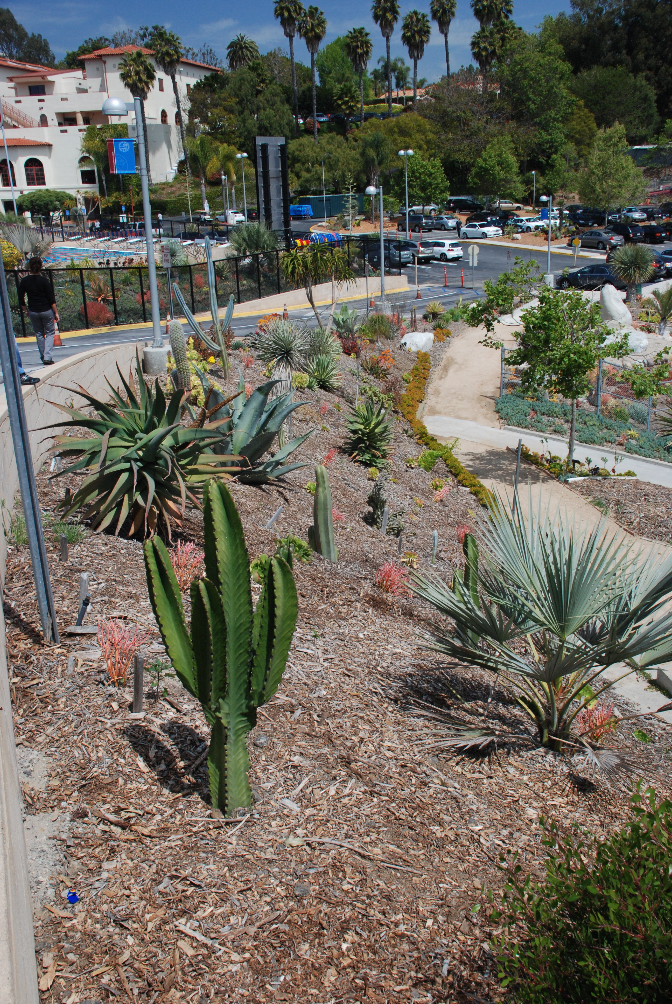
Regional Turf Removal
$1 per sq/ft
Agencies may add $
Some agencies may apply local rules

Slide 21
Other New Information
On-site retrofits for recycled water
Outreach campaign to support call for conservation efforts
Increase funding for conservation:
$20M to be available across FY 14 and FY 15
Avoid restricting program activity
Allow public opportunity to save water

